Slide 1
TECHNICAL PJT TEAM
AUTO MULTI WRITING SYSTEM
2020. 10. 28
Pham Gia Tri
7197712
Ho Van Tan
7209115

Slide 2

Introductions
Software
Main window
Report manager window
Micom controller board
Block diagram

Slide 3
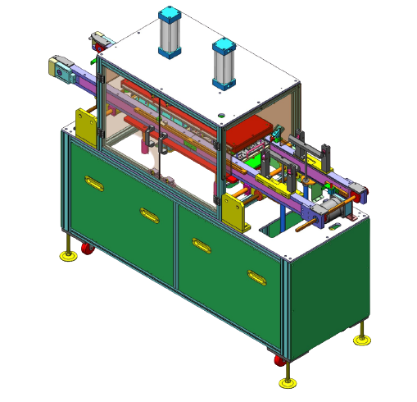
Introduction
Program MCU inline, up to 4 MCU same time
Able to load 4 diff program
Easy setup and operation
High reliability
Accurate statistics
Programmed by DEV engineers

Slide 4

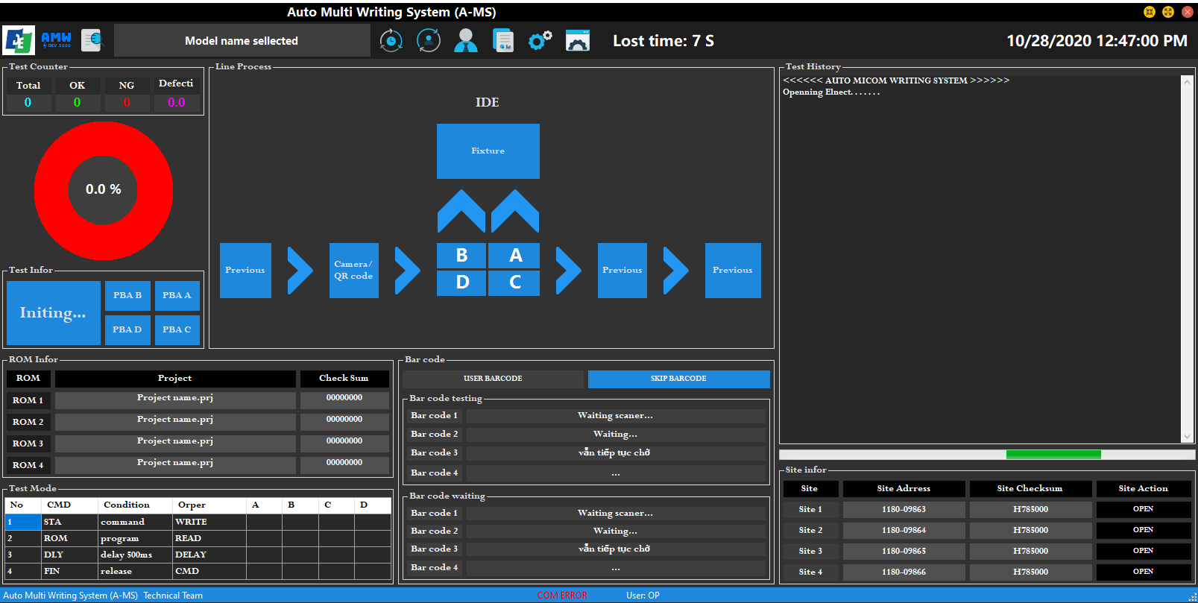
1. Software
a. User interface (Main window)
Auto/ Manual programming
FAIL Warning
Jig layout preview
History result
ROM information
Elnec programmer infor
Daily statistics
Design by DEV engineer : Hồ Văn Tân

Slide 5
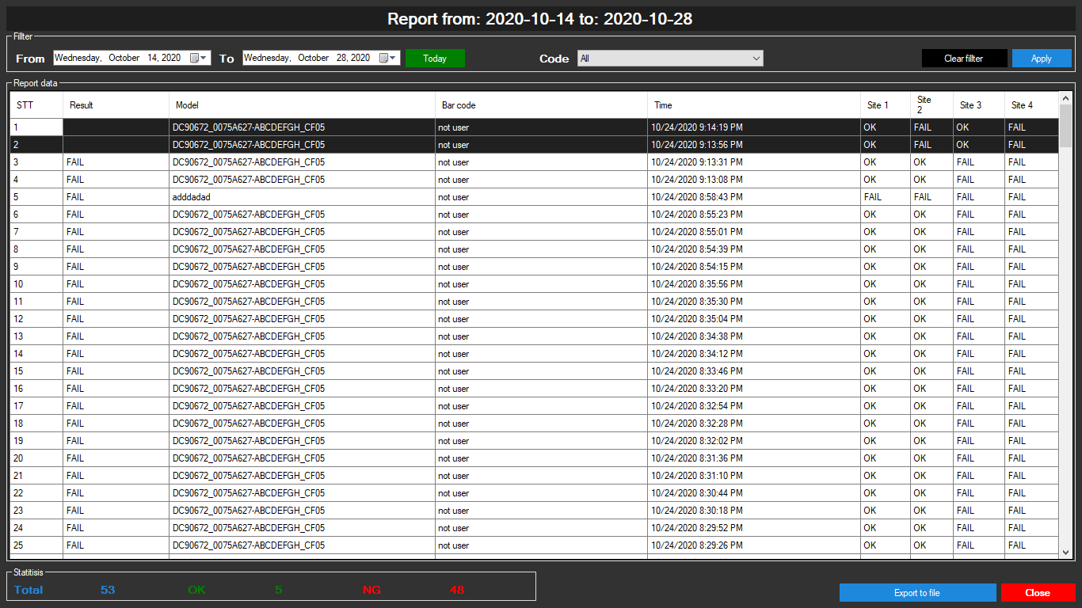
1. Software
b. User interface (Report window)
Report data viewer
Filter by date time
Fillter by Model code
Extract filtered data
Displays the number of OK / FAIL on the data page
Design by DEV engineer :Hồ Văn Tân

Slide 6
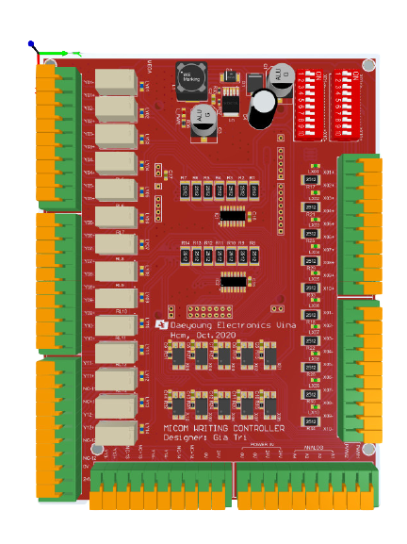
2. Micom Writing Controller Board
Control input PLC’s signals
Communication with software
Specifications:
Power : 24 VDC
Input: 0 - 24V x 10
Output: 0 – 24V x 14
Design by DEV engineer : Pham Gia Tri

Slide 7
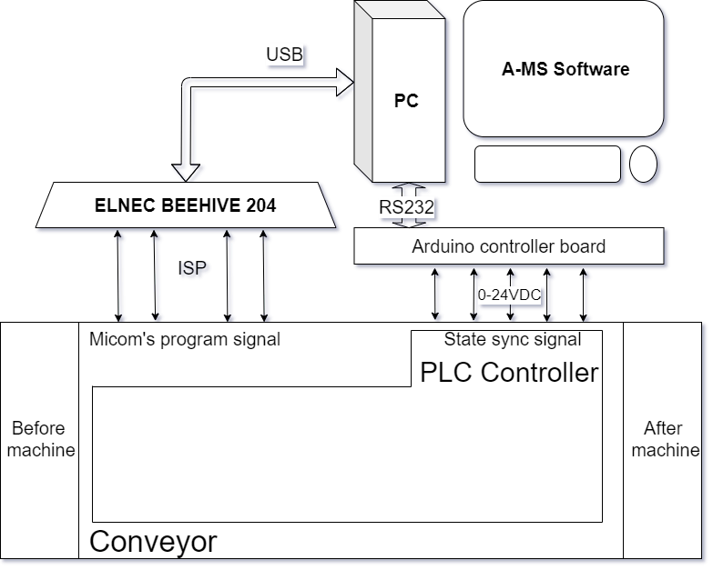
3. Block diagram
Run/Stop conveyor
Up/down Jig
Warning bug
Push NG board

Slide 8
TECHNICAL TEAM
2020. 10. 28
Pham Gia Tri
7197712
Ho Van Tan
7209115

